Slide 1

TEAM 5
RUFFIN REMAD
ROX NGUYEN
PRABHU KHAIRNAR
NUR E SIAM
XAVIER O’LEARY

Slide 2
INTRODUCTION
PROJECT BACKGROUND:
The background of the project is to work in a team to propose a solution for the Archery Club’s data management problem by applying design thinking approaches.
SUMMARY OF REQUIREMENTS:
The requirements for this project include initial and final ER diagrams, table statements, data creation and null values, indexes, use cases and transactions. All of these requirements were documented in Confluence as part of the Final Report

Slide 3
MISSION STATEMENT & OBJECTIVES
To make a database that collects data of archers to help them look at their records and allow them enhance their performance that would raise their level in the game.
The aim will be to keep track of archers' performance and compare with other players for in-depth analysis.

Slide 4
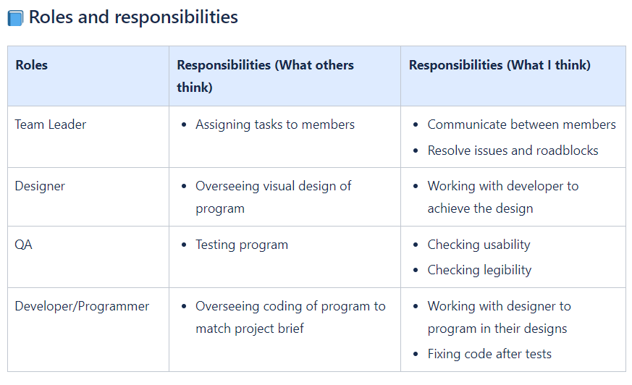
TEAM PROCESS
COLLABORATION: The team has worked together online and offline to get to final product by arranging regular meetings and checking up workflow with Jira Work Management and Confluence software.
ROLES: Each member played vital roles in finishing the project with work divided between them.
CONTRIBUTIONS TO SOLUTION: Team divided their roles to complete specific tasks.

Slide 5
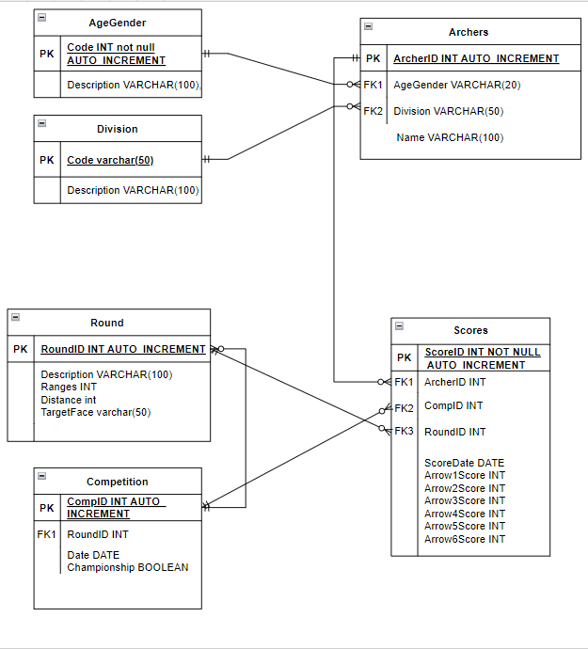
LOGICAL DESIGN
Improvement of ER diagram to show six tables and their relationship

Slide 6
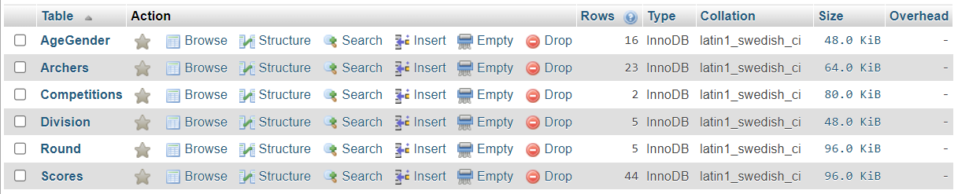
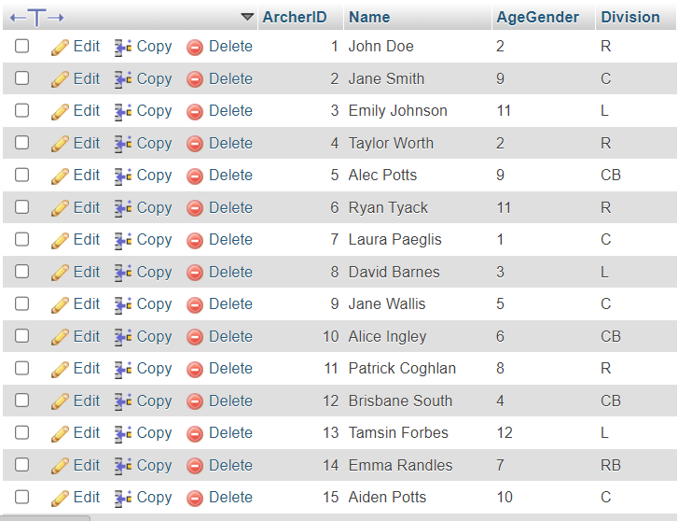
LOGICAL DESIGN
Tables and their data on MySQL database

Slide 7
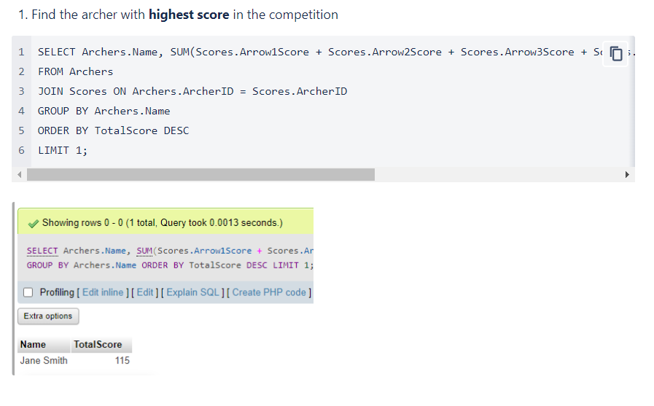
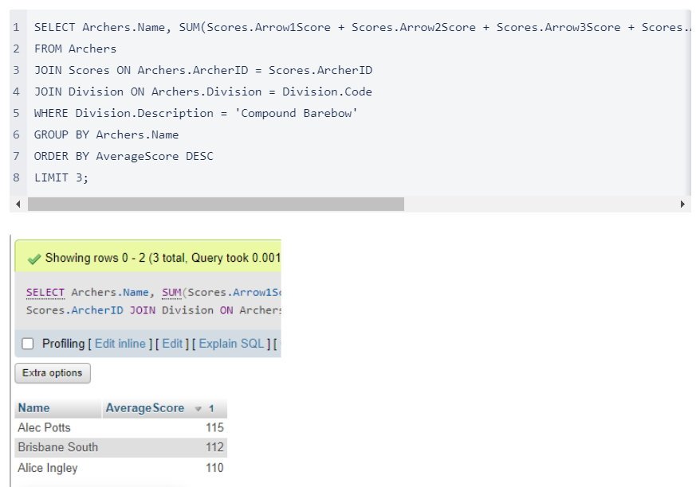
USE CASES
Use cases to show specific data

Slide 8
SUMMARY & LESSONS LEARNT
Create objectives, break tasks, assign resources, set deadlines, and use Confluence's features to visualize and track the project plan.
Facilitate team communication and collaboration by using Confluence to compile and coordinate work effectively.
MySQL supports various data types in its database system, and using it allows executing use cases while facilitating data management and analysis.

